Slide 1
Recovering America’s Wildlife
State-by-State
Naomi Edelson
Sr. Director, Wildlife Partnerships
National Wildlife Federation
Notes:
Introduction

Slide 2
National Wildlife Federation
Uniting all Americans
to ensure that wildlife thrive
in a rapidly changing world

Slide 3
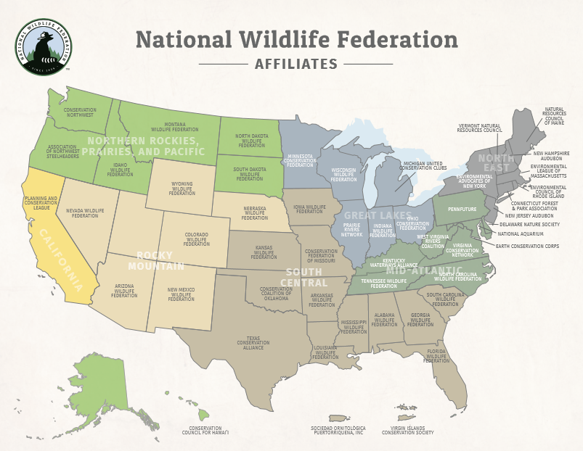
Notes:
Affiliates really engaged: AK, AR, AZ, CA, CO, DE, FL, GA, IA, ID, IL, OK, MT, NC, NH, NJ, NM, OR, SD, TN, TX, WA, WY

Slide 4
Stated-Based Funding
to Prevent Wildlife
from Becoming Endangered
Federal (in play) and
State (examples)

Slide 5
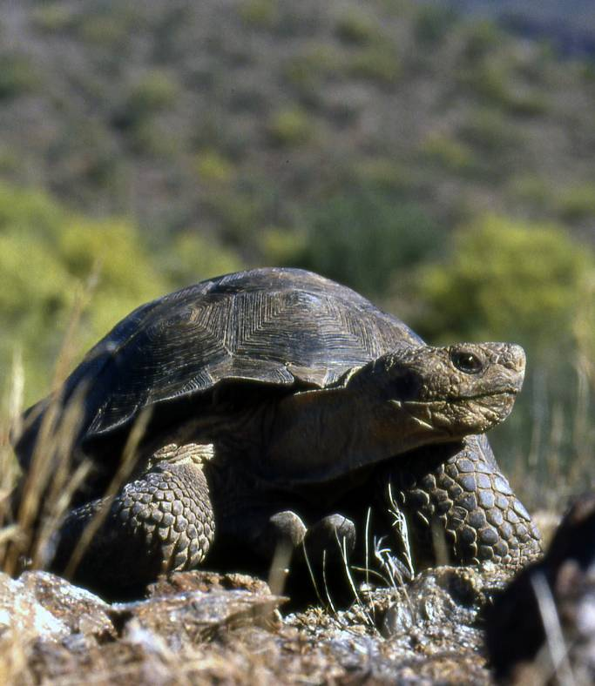
Current State Wildlife Funding
User Fees from Hunters and Anglers
State licenses, permits, etc
Federal excise taxes from gear (greater than $1 B/year)
Almost NO state general funds
Key exceptions (MO, AR, MN)

Slide 6
Investments Pay Off
Wild Turkey, pronghorn, striped bass, white-tail Deer

Slide 7
BUT NOT FOR ALL WILDLIFE
America’s wildlife crisis

Slide 8
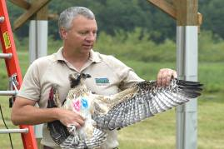
Bake Sale Approach
License Plates
Tax Check-offs
Stamps
Individual Donors

Slide 9
1/3 of America’s Wildlife At Risk
70% freshwater mussels
42% reptiles and amphibians
40% freshwater fish
33% bird species
25% bumblebees
17% butterflies
Notes:
Consequences of minimal funding, bake sale approach

Slide 10
Monarchs 90% Decline

Slide 11
Cerulean Warbler
74% Decline
Notes:
Photo: Cerulean Warbler (over the past several decades the species has suffered a 74% population decline)

Slide 12
New Report
Collaboration between National Wildlife Federation, American Fisheries Society, and The Wildlife Society
Up to 1/3 of Wildlife Species are at risk
Highlights conservation successes
Notes:
Photo on report: Swift Foxes– info on swift foxes included in the report

Slide 13
State Fish and Wildlife Agencies are the key to solving the wildlife crisis
State wildlife agencies employ thousands of highly qualified biologists
Manage millions of acres of habitat
Education and Recreation part of mission
Close relationships with private landowners
State Wildlife Action Plans aimed at preventing wildlife from becoming endangered

Slide 14
Funds are needed for:
Habitat restoration and acquisition
Species reintroductions
Research
Surveys and Monitoring
Conservation Education
Recreation
Law Enforcement

Slide 15
Campaign
Elevate Wildlife Crisis
Build Conservation Army Big Tent Coalition Pass Legislation
Federal and State

Slide 16
Notes:
Affiliates really engaged: AK, AR, AZ, CA, CO, DE, FL, GA, IA, ID, IL, OK, MT, NC, NH, NJ, NM, OR, SD, TN, TX, WA, WY

Slide 17
Missouri
Increase in Sales Tax
1/8 of one cent
Department of Conservation
“Design for Conservation”
1976

Slide 18
Arkansas
Increase in Sales Tax
1/8 of one cent
Wildlife, Parks, Heritage, Anti-Litter
“Keep Arkansas Natural”
1996

Slide 19
Minnesota
Increase in Sales Tax
3/8 of one cent
Wildlife Habitat, Parks and Trails,
Clean Water, Arts
$300M/year (240 for conservation)
2008

Slide 20
Texas and Virginia
Existing Sales Tax
National Survey Wildlife Recreation
Wildlife Agencies
Up to $32 Million and $13 Million
1993 and 1998

Slide 21
“Extractive” Fees
NV ($500k)
PA (water)
ND and PA (gas and oil)

Slide 22
Federal Funding
Current federal funding is less than 5% ($70 million) of what is necessary to conserve species
most at-risk
Notes:
Photo: Gopher Tortoise

Slide 23
Recovering America’s Wildlife Act (H.R. 4647)
NAME: Naomi Edelson
EMAIL:EdelsonN@NWF.org
PHONE:202-790-6889
Notes:
Introduction

Slide 24
State Based Decision Making
State wildlife agencies are key
Blueprint for whole state
State Wildlife Action Plans aimed at preventing wildlife from becoming endangered
Notes:
Photo: Golden Winged Warbler

Slide 25
State Wildlife Action Plans
In 2000, Congress mandated that state wildlife agencies develop State Wildlife Action Plans
Plans Identify priorities for conserving species, their habitats, and the actions needed to sustain and restore vulnerable populations
Notes:
Photo: U.S. Brook Trout

Slide 26
PRICE TAG
$1.3 B to implement 75% of State Wildlife Action Plans
Recovering America’s Wildlife Act = $1.3 Billion in Federal funds
25% state match
Notes:
Photo: U.S. Brook Trout

Slide 27
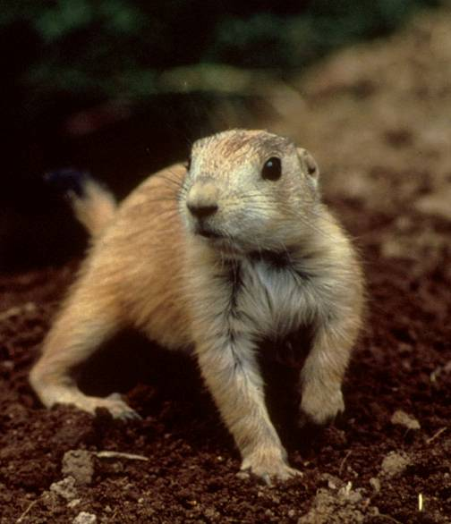
How much money for my state?
HOW MUCH MATCH?

Slide 28
Broad Support
Blue Ribbon Panel
CEOs, including Collin O’Mara, NWF
Outdoor Recreation Retailers & Manufacturer
Energy Industry
Other Conservation Entities

Slide 29
National Sign-On Letter
MORE THAN 1000 ORGANIZATIONS AND BUSINESSES HAVE SIGNED ON!
Including:
Bass Pro Shops
The Avett Brothers
Pheasants Forever
Duke Energy
Audubon

Slide 30
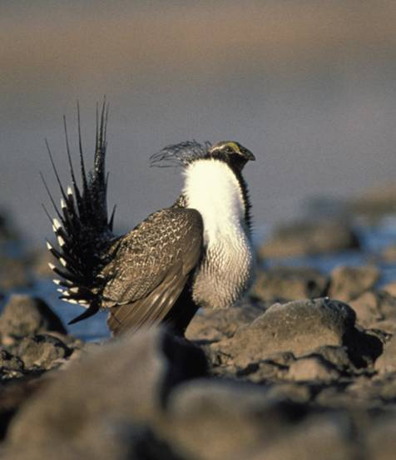
Nevada Legislature Resolution of Support

Slide 31
Good for wildlife Good for taxpayers Good for businesses
Notes:
Photo: New England Cottontail (different from regular cottontail)– case study highlighted in Wildlife Crisis Report
An economic boost. Americans spend $140 billion dollars on wildlife-focused recreation every year. An investment in wildlife conservation will result in more outdoor opportunities for all outdoor enthusiasts.
Cost- effective. Once wildlife reaches the point of needing ESA intervention it is harder and much more expensive to recover, and it is more challenging for business. Proactive efforts provide more regulatory certainty for businesses saving them substantial money and time.
Benefits people and wildlife. Diverse fish and wildlife and their habitats provide important contributions like clean water and air, flood prevention, pollination, and carbon capture.
No tax increase. Half the funds ($650 million) will come from existing revenues from energy development on the outer continental shelf and the other $650 million will come from existing revenues from mineral development on federal lands. These funds currently go into the U.S. Treasury.
No impact on LWCF. This proposal is not connected to and would not impact funding for the Land and Water Conservation Fund. Offshore oil and gas funding from public lands and waters range from $5-12 billion a year.
Better for hunters and anglers. Currently, 80 percent of the funding for our state wildlife agencies comes from state hunting and fishing licenses and permits as well as federal excise taxes on hunting and fishing gear. This funding model has worked for decades but has reached its limit. This would expand the funding source to all Americans and modernize conservation funding for the nation

Slide 32
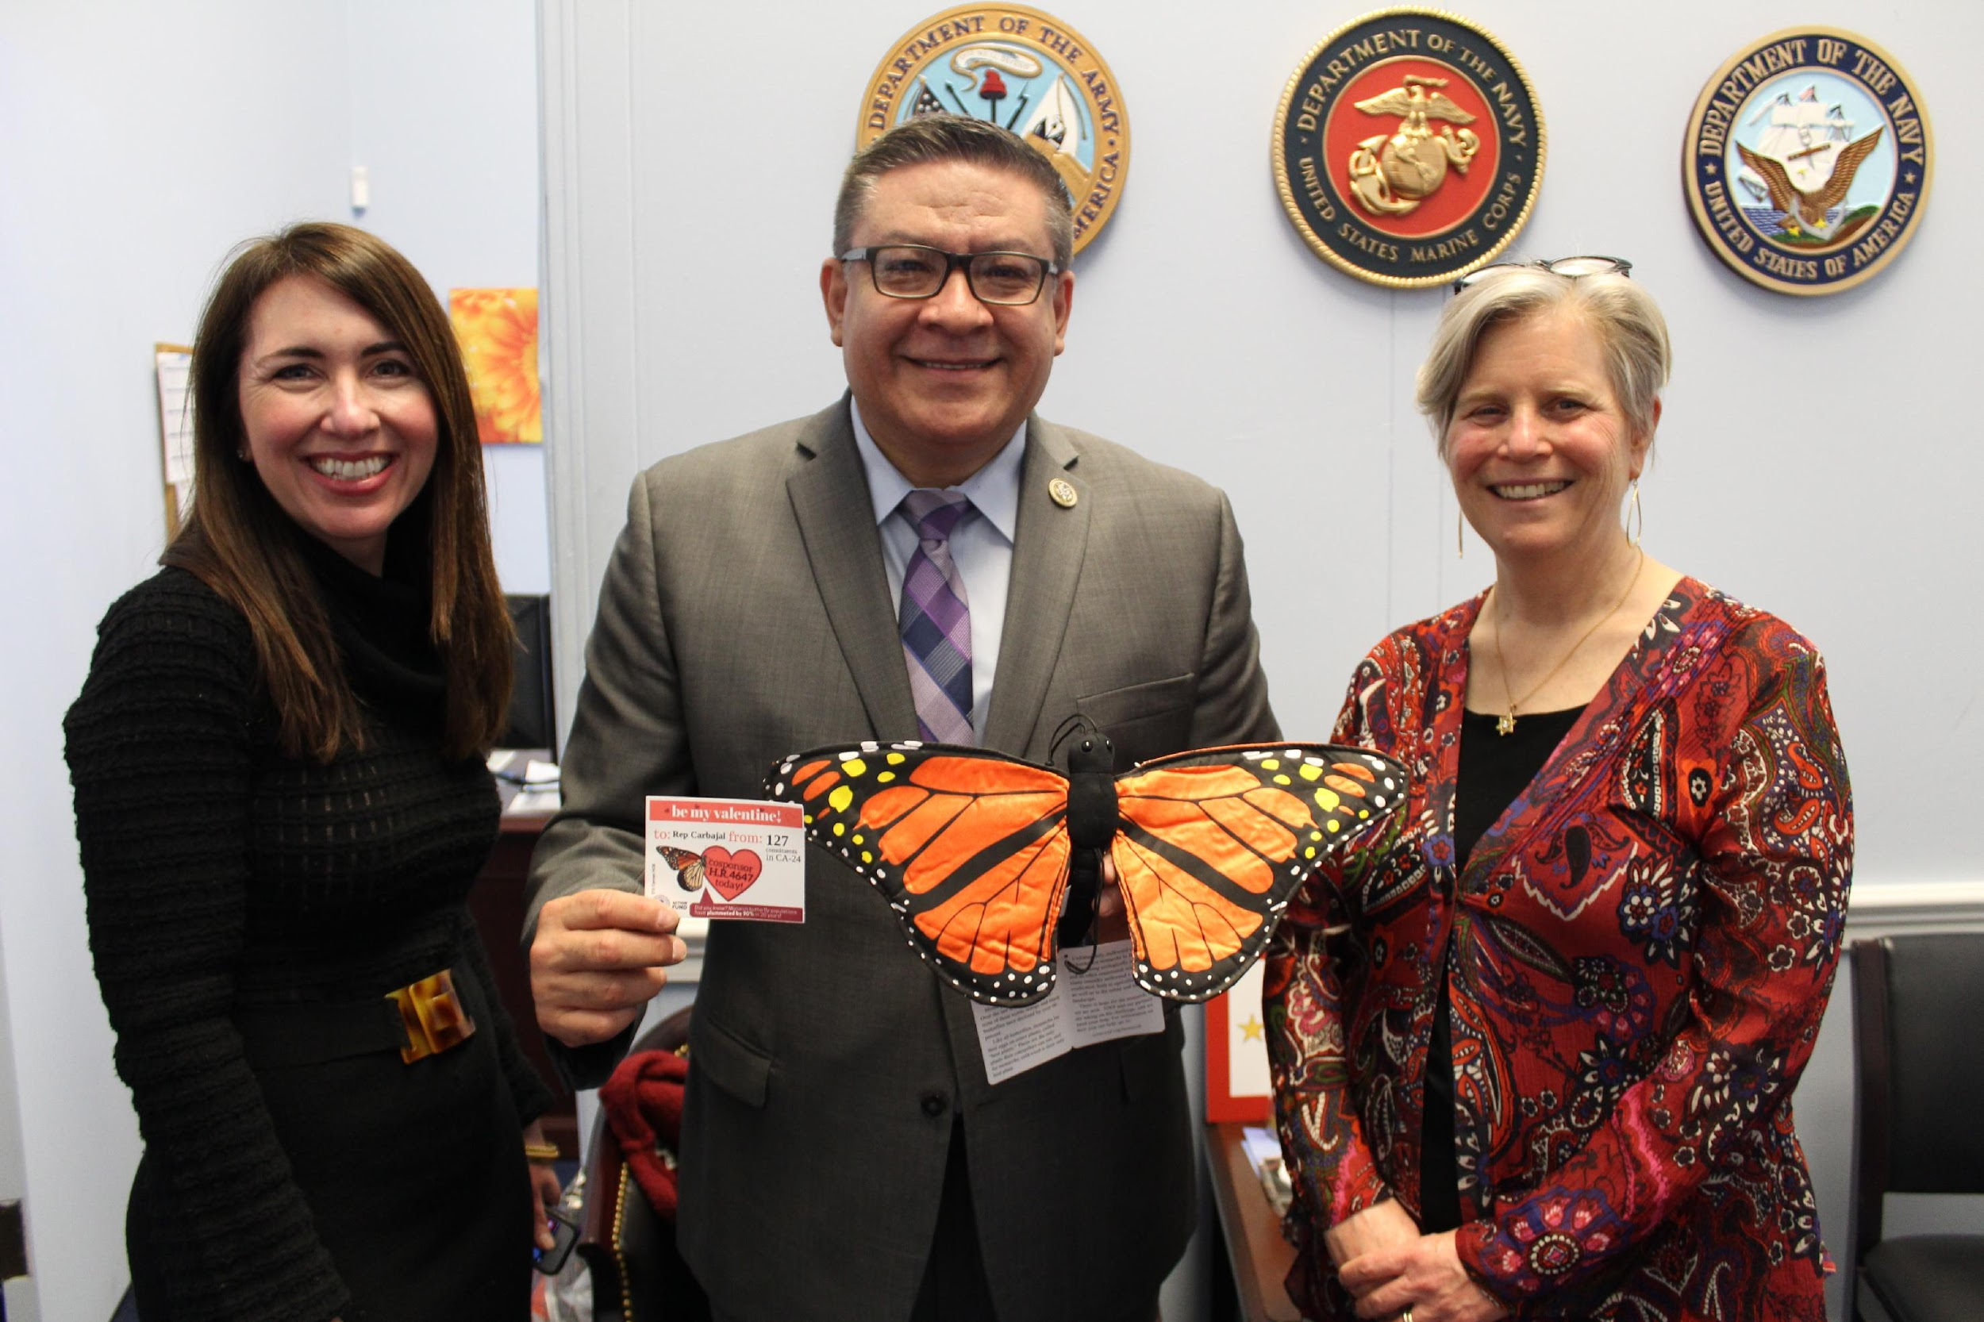
Notes:
Photo: (Left to Right) Drue Winters-American Fisheries Society, Rep. Salud Carbjaja (D-California) and Naomi Edelson-National Wildlife Federation

Slide 33
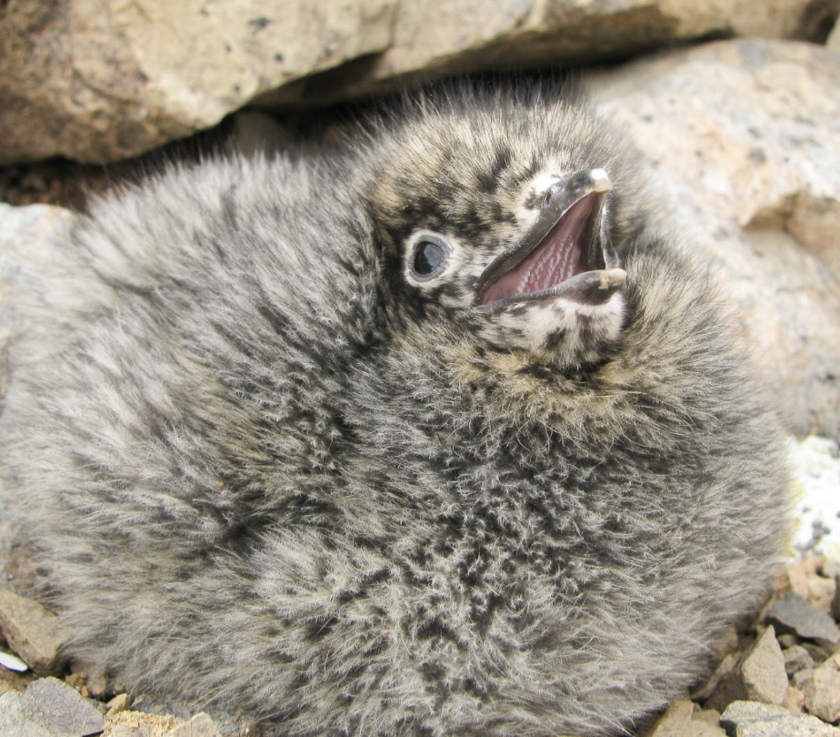
Bipartisan support
Fortenberry and Dingell
90 co-sponsors
Notes:
Photos: Tops bird= Kittlitz’s Murrelet; Bottom bird= baby Kittlitz’s Murrelet

Slide 34
Bipartisan support
Senate bill just introduced
Notes:
Photos: Tops bird= Kittlitz’s Murrelet; Bottom bird= baby Kittlitz’s Murrelet

Slide 35
Contact Information
National Wildlife Federation:
Naomi Edelson
Senior Director of Wildlife Partnerships
Email: EdelsonN@nwf.org

