Slide 1
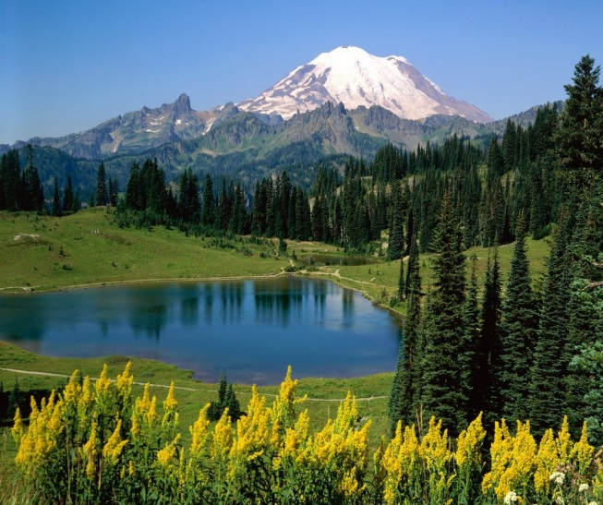
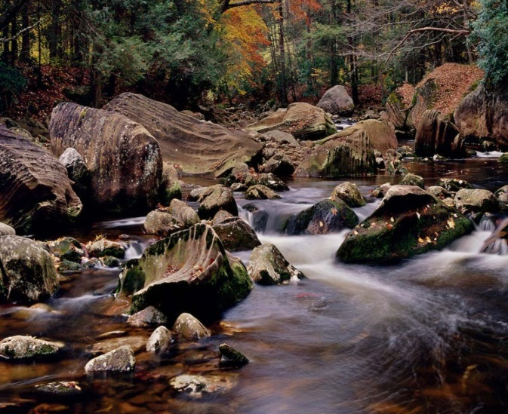
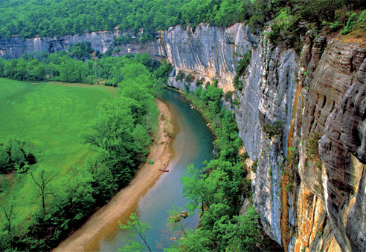
American Attitudes and Messaging on Wildlife & Conservation
Lori Weigel
lori@pos.org | (303) 324 7655
Dave Metz
dave@fm3research.com | (510) 451 9521

Slide 2
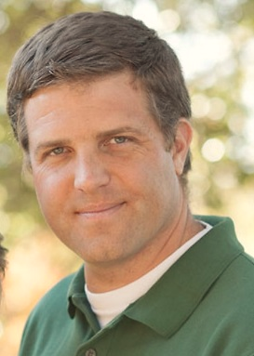
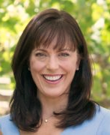
Bipartisan Research Team
Fairbank, Maslin, Maullin, Metz & Associates (FM3) – a national Democratic opinion research firm with offices in Oakland, Los Angeles and Madison, Wisconsin – has specialized in public policy oriented opinion research since 1981. The firm has assisted hundreds of political campaigns at every level of the ballot – from President to City Council – with opinion research and strategic guidance. FM3 also provides research and strategic consulting to public agencies, businesses and public interest organizations nationwide.
Dave Metz – FM3
Public Opinion Strategies (POS) is the largest Republican polling firm in the country. Since the firm’s founding in 1991, they have completed more than 10,000 research projects, interviewing more than five million Americans across the United States. Media outlets, such as The Wall Street Journal, NBC News, CNBC, and National Public Radio, rely on Public Opinion Strategies to conduct their polling. The firm conducts polling on behalf of hundreds of political campaigns, as well as trade associations, not-for-profit organizations, government entities and industry coalitions throughout the nation.
Lori Weigel - POS
As a bipartisan team, FM3 and Public Opinion Strategies have researched a wide range of issues for nearly a decade, in particular on conservation-related initiatives and policies. Together, the two firms have jointly conducted research on behalf of political campaigns, businesses, not-for-profit organizations and public agencies in 44 states and nationally.

Slide 3
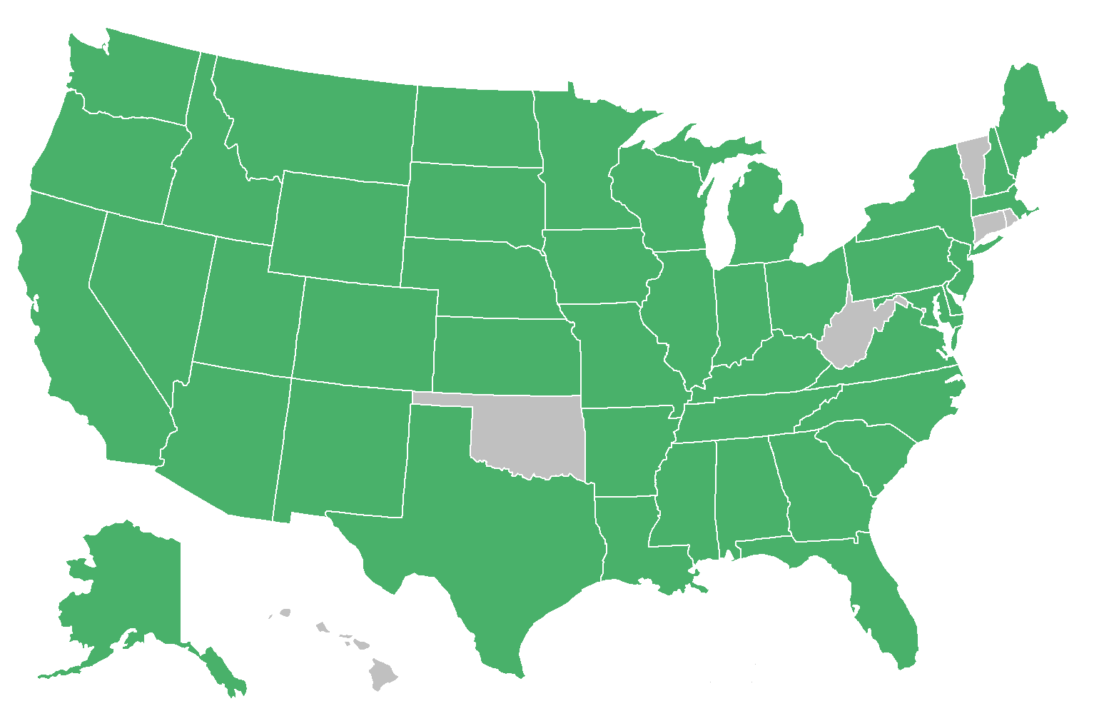
FM3 and POS have partnered to complete environmental research in 44 states.

Slide 4
Some of the Topics We Have Researched:
Conservation ballot measures in more than 20 states
Increased funding for land and water conservation, including RESTORE funding and full funding of the Land and Water Conservation Fund
Conservation of working forests to secure greater funding in Ag bills
Management of U.S. fisheries
Ecological role of fires
Climate and energy issues
Sea level rise and flooding in coastal and riverine areas
Children in nature research in five countries in a unique collaboration between The Nature Conservancy and Disney
Assessing teenager attitudes regarding outdoor recreation, including habits and competing interests, with a special focus on minority teens
Species specific research, e.g. Alaskans re: salmon; sage grouse recovery, etc.
Assessing branding and marketing efforts on behalf of conservation organizations to diverse audiences outside their typical donor base, particularly among younger voters

Slide 5
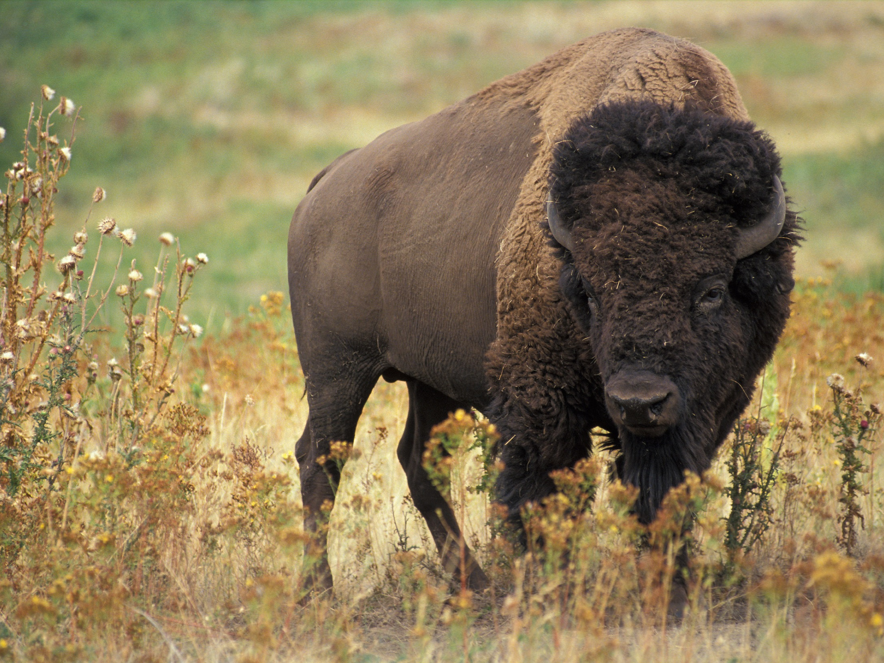
American Attitudes and Messaging on Wildlife and Conservation

Slide 6
Our summer 2012 survey showed only about one-third of voters highly concerned about loss of wildlife habitat.
Issues Ranked By Extremely/Very Serious | % Extremely/ Very Serious | % Total Serious
The economy and unemployment | 80% | 97%
The federal budget deficit | 76% | 93%
Too much government spending | 65% | 82%
Kids not spending enough time outdoors and in nature | 50% | 82%
Pollution of rivers, lakes and streams | 42% | 76%
Pollution of oceans | 40% | 66%
Loss of property rights | 39% | 65%
After-effects of the oil spill in the Gulf of Mexico on wildlife and natural areas | 39% | 62%
Global warming | 36% | 60%
More frequent droughts | 35% | 62%
Not enough planning by local governments trying to direct how and where growth occurs in their communities | 34% | 67%
Loss of habitat for fish and wildlife | 34% | 63%

Slide 7
Concern is concentrated in the West and South.
% Total Extremely/Very Serious
Concern About Loss of Habitat for Fish and Wildlife by Region

Slide 8
Hispanic voters are more concerned than others.
% Total Extremely/Very Serious
Concern About Loss of Habitat for Fish and Wildlife by Ethnicity

Slide 9
Concern about the issue is fundamentally partisan.
% Total Extremely/Very Serious
Concern About Loss of Habitat for Fish and Wildlife by Party

Slide 10
Two factors are more important than ANY other
in determining a voters' connection to wildlife.
"Wildlife are an important part of my daily life."
Overall
% Strongly Agree By Geography
46%
28%
34%
25%
56%
Big
Suburban
Small
Rural
43%
City (15%)
Area (31%)
Town (29%)
(25%)
% Strongly Agree Among Sportsmen and Non-Sportsmen
33%
59%
Strongly
47%
28%
15%
Strongly
Agree
Disagree
Both Licenses
One License
Non-Sportsmen
(12%)
(16%)
(72%)
Now I would like to read you a few statements about wildlife. For each
one, please tell me if you agree or disagree with that statement...

Slide 11
The “connection” to wildlife is significantly
stronger among the advocates interviewed.
"Wildlife are an important part of my daily life."
Among Voters
Among Advocates
95%
56%
71% Strongly
43%
33% Strongly
15% Strongly
5%
Agree
Disagree
Agree
Disagree
Now I would like to read you a few statements about wildlife. For each
one, please tell me if you agree or disagree with that statement...

Slide 12
The vast majority have had some wildlife experience.
Ranked By % Yes Among Voters
Fed birds or animals near your home
74%
74%
Visited a zoo or aquarium
56%
51%
Visited a natural area solely to view
52%
wildlife or birds
70%
Been hiking
50%
67%
Visited a wildlife sanctuary^
40%
65%
Been camping
33%
41%
Had a hunting or fishing license*
28%
42%
All Voters
Advocates
* In past three years ^ Among activists, asked as “Visited a wildlife refuge”
Some people we have talked to this evening have done some of the following
activities, while others have not. So, in the last year have you…

Slide 13
Advocates are just as likely to view
wildlife as faring well today.
Health Of Wildlife
Number of Wildlife
58%
61%
58%
57%
11%
9%
6%
8%
Voters
Advocates
Voters
Advocates
Excellent
Good
Generally speaking, in terms of the
HEALTH
of
Generally speaking, in terms of the
NUMBER
of
wildlife in your state, would you describe the
wildlife in your state, would you describe the
condition of wildlife as ...
condition of wildlife as ...

Slide 14
But, advocates are much more likely to
view wildlife as in “crisis” in their state.
"Wildlife are in crisis in my state.
"
Among Voters
Among Advocates
66%
39%
19% Strongly
22% Strongly
Agree
Agree
Now I would like to read you a few statements about wildlife. For each
one, please tell me if you agree or disagree with that statement...

Slide 15
Still, voters perceive a number of
threats to wildlife in their state...
Among Voters
By % Major Threat
Over-development
67%
91%
Loss of wildlife habitat
66%
91%
Pollution
65%
92%
The impact of industry, such as
48%
80%
logging in forests
Roads and highways
46%
89%
Disease
35%
80%
Major Threat
Minor Threat
Now, thinking about some problems which may or may not affect wildlife. I would like to read you some
things which might affect wildlife negatively, and please tell me for each one whether you think that is a
major threat, a minor threat or not a threat to wildlife in your state...

Slide 16
As do advocates, who say a broader range of
issues are negatively affecting wildlife.
Among Advocates
By % Major Threat
Over-development/ Sprawl
91%
99%
Water pollution
73%
97%
Non-native, invasive species
63%
96%
Air pollution
46%
92%
Climate change
43%
87%
Mining or oil and gas drilling
37%
75%
Disease
35%
95%
Major Threat
Minor Threat
Now, thinking about some problems which may or may not affect wildlife. I would like to read you some
things which might affect wildlife negatively, and please tell me for each one whether you think that is a
major threat, a minor threat or not a threat to wildlife in your state...

Slide 17
Advocates feel better positioned to take a stand that
more needs to be done to help wildlife in their state.
Among Voters
Among Advocates
More Needs
To Be Done
More
40%
Needs To
Be Done
87%
Enough
Being
Done
Refused
19%
1%
Don't Know
Too Much
Enough
Being Done
Enough
7%
Don't Know
Being
Too Much
7%
Enough
Done
Being
33%
6%
Done
1%
Voter Wording: And, would you say – more needs to be done to help wildlife in your state or enough is being done to
help wildlife in your state – or do you not feel you know enough to say one way or the other?
Advocate Wording: And would you say that more needs to be done to help wildlife in your state, that enough is being
done to help wildlife, that too much is being done, or that you do not know enough to say one way or the other?

Slide 18
The real difference between voters and
advocates is the willingness to prioritize
wildlife among competing issues.
"
Wildlife are important, but there are higher priorities
in my state which need funding."
Among Voters
Among Advocates
75%
38%
40% Strongly
Agree
5% Strongly
Agree
Now I would like to read you a few statements about wildlife. For each
one, please tell me if you agree or disagree with that statement...

Slide 19
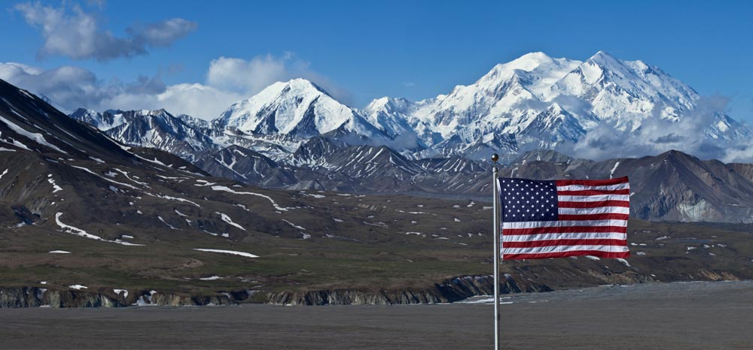
We the People

Slide 20
Americans say they visit national public lands.
 | Western States | National
Once or twice | 21% | 32%
3-5 Times | 25% | 25%
6-10 Times | 18% | 11%
11-20 Times | 12% | 6%
More than 20 Times | 17% | 4%
Visited | 93% | 78%
And over the past year, how many times do you think you have visited public lands managed by one of the national agencies I mentioned before, such as national parks, national forests, national monuments, national wildlife refuges, or other national public lands?

Slide 21
And that they engage in outdoor recreation.
Western States | National
59% | 40%
52% | 32%
31% | 28%
22% | 25%
20% | 14%
20% | 11%
Hiking
Camping
Boating
Mountain biking
Riding an off-road vehicle
or snowmobile
Bird watching and
viewing wildlife
Which of the following types of outdoor recreation do you participate in regularly?

Slide 22
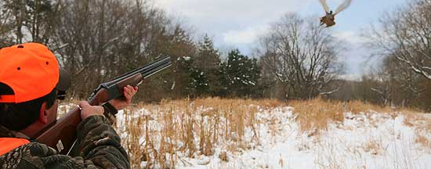
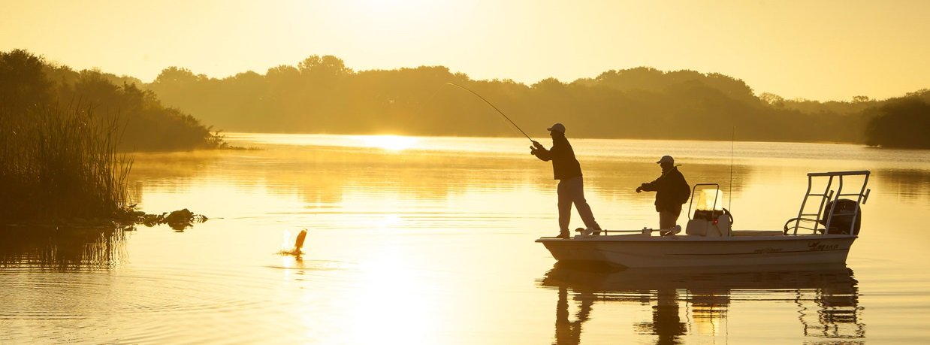
Including hunting and fishing.
Sportsmen are a significant proportion of the electorate in these Western swing states.
Western States
National
27%
21%
Hunters
34%
25%
Anglers
“Do you consider yourself a hunter, an angler or both?”

Slide 23
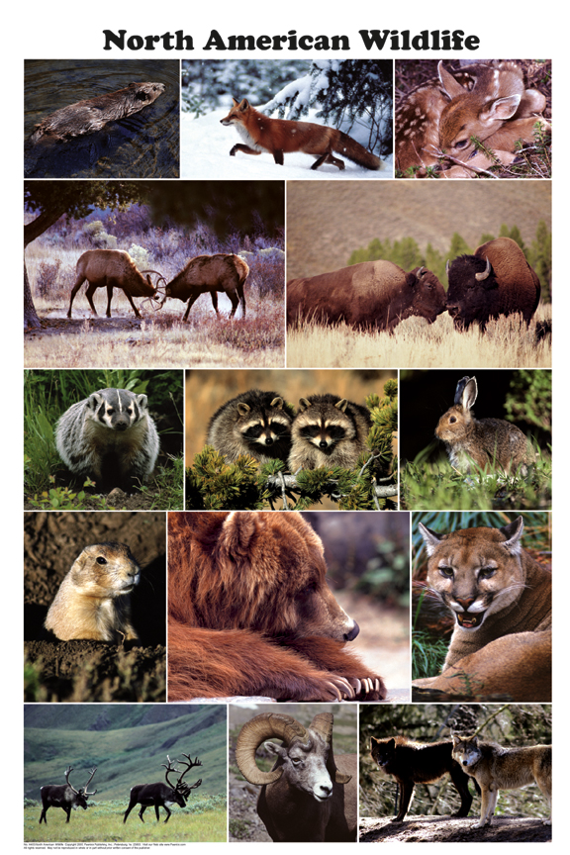
Talk about ALL Wildlife

Slide 24
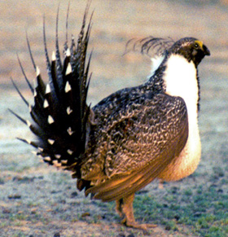
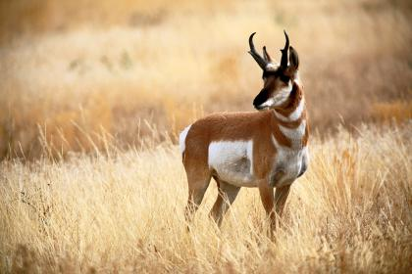
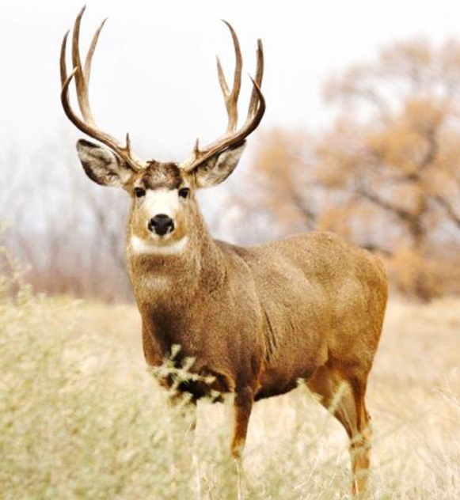
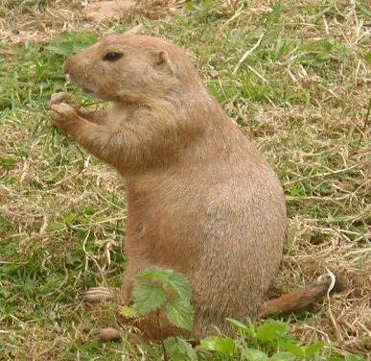
Multiple species trump a single species consistently in our research.

Slide 25
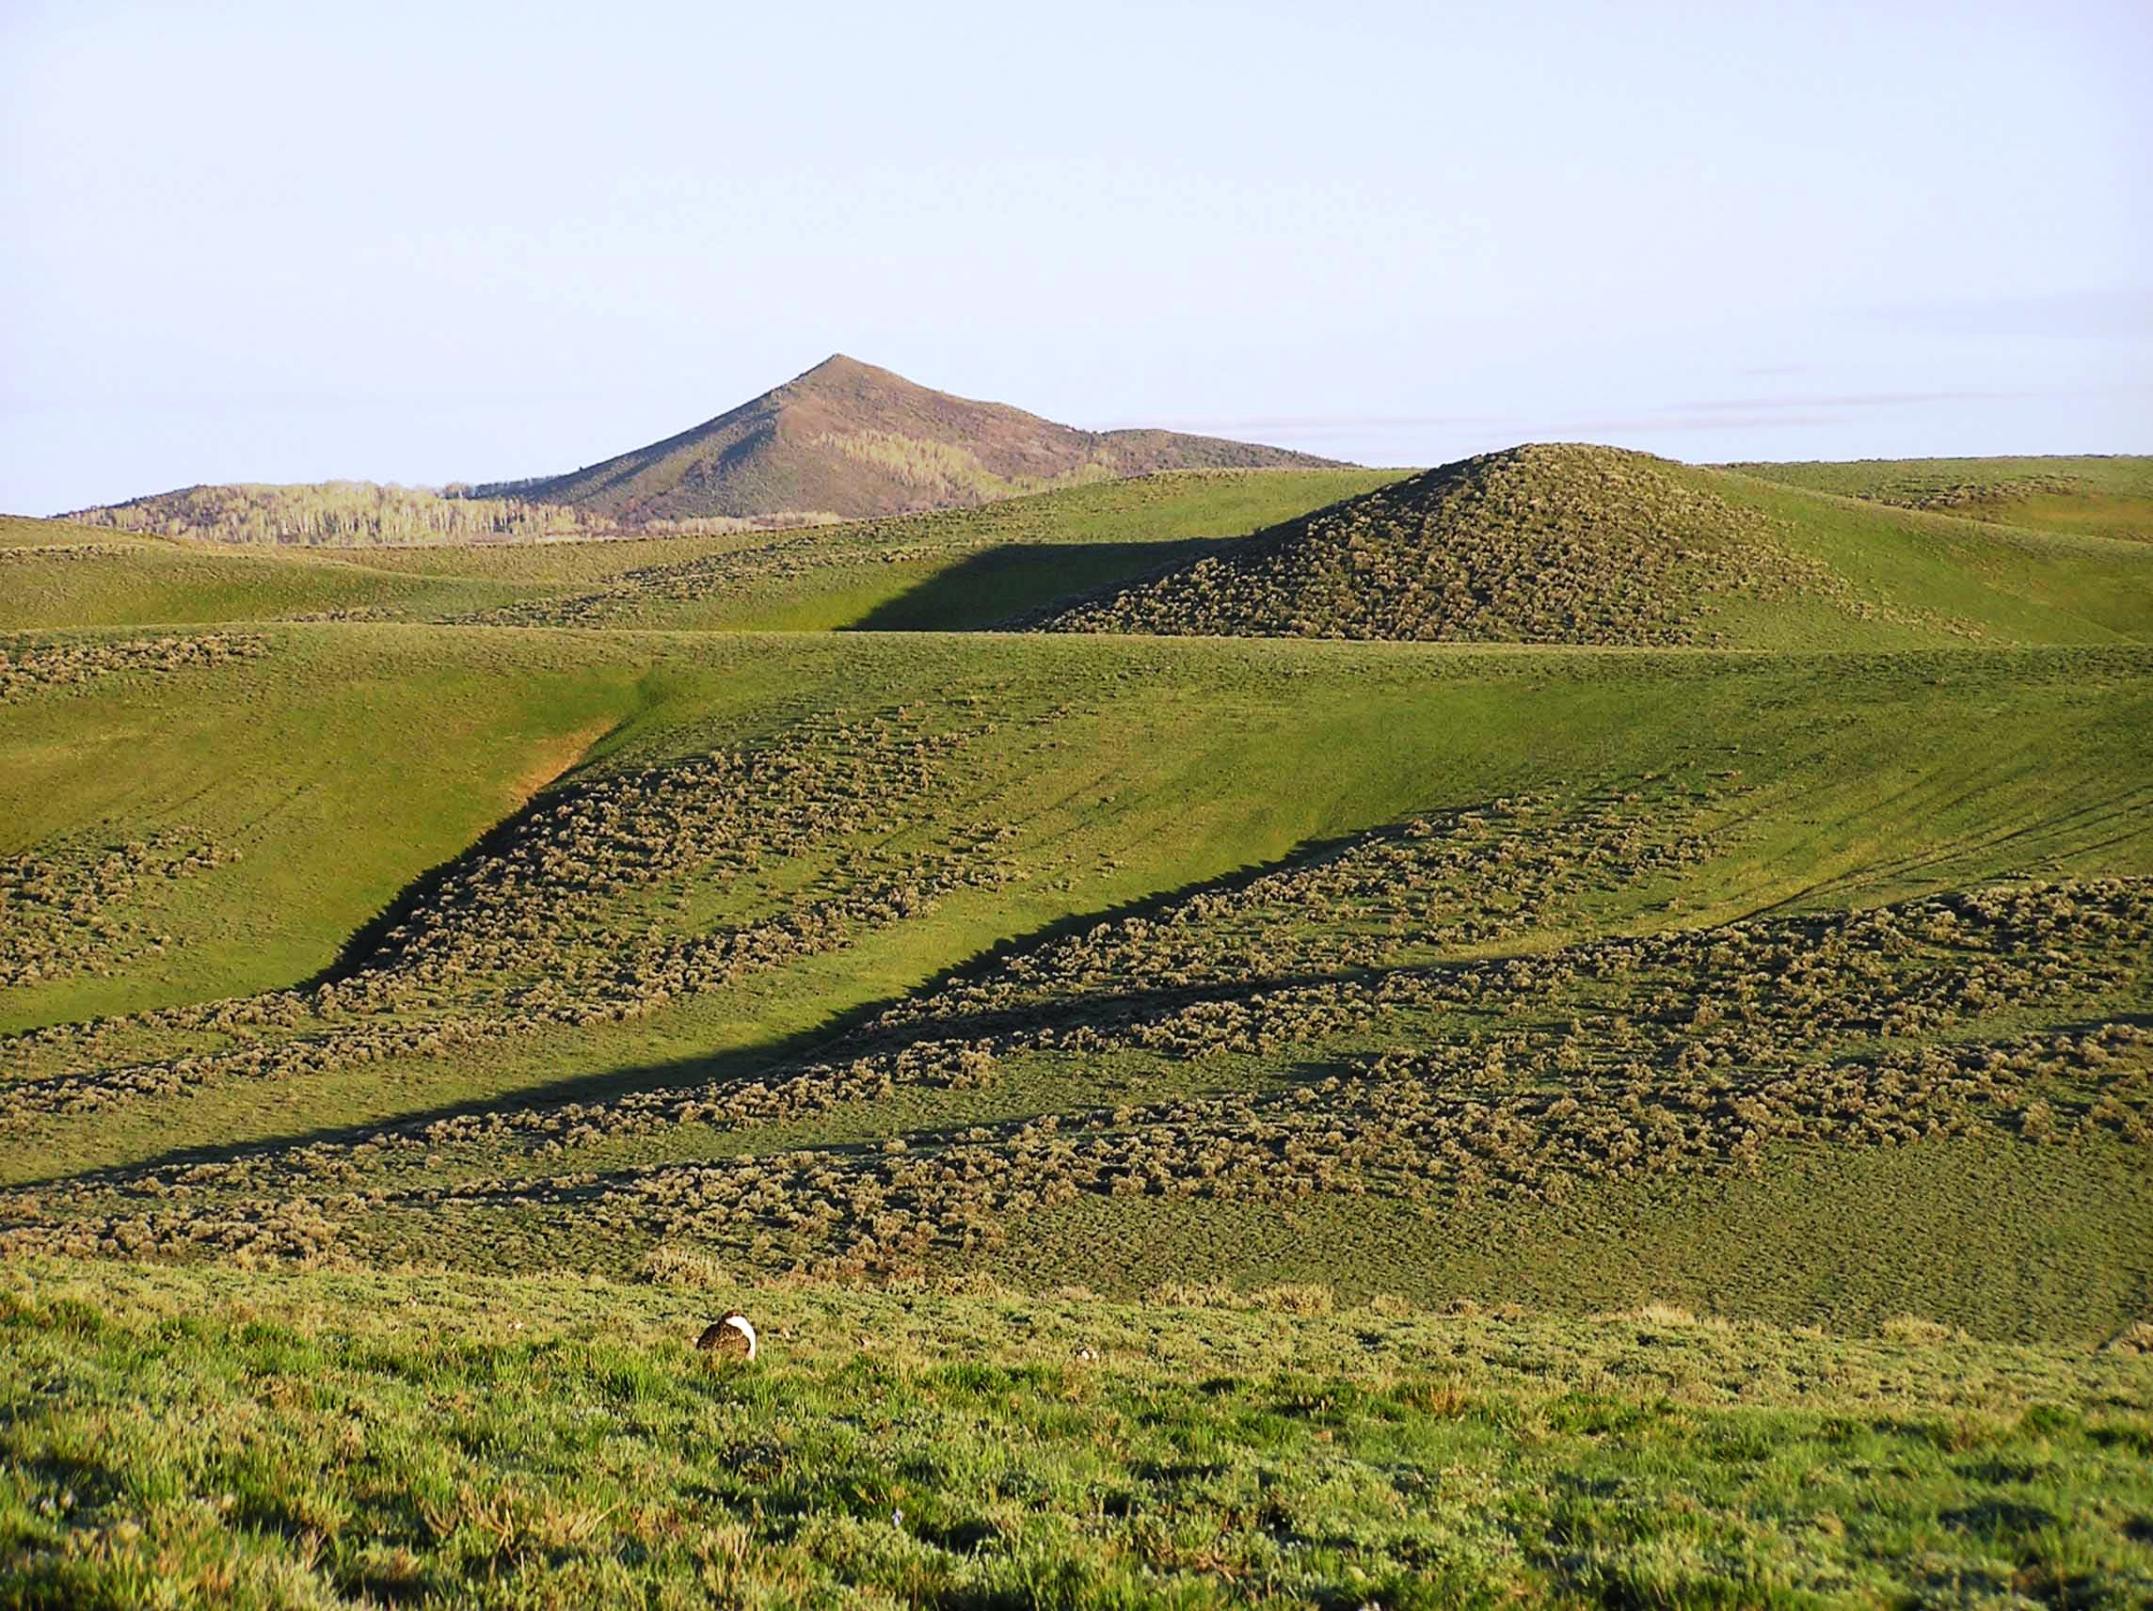
Voters reject the idea of “prioritizing” certain species. They believe wildlife are intimately connected and what affects one will affect others.
Agree
We have an obligation to protect ALL kinds of wildlife.
91%
Data from 2005 National Survey

Slide 26
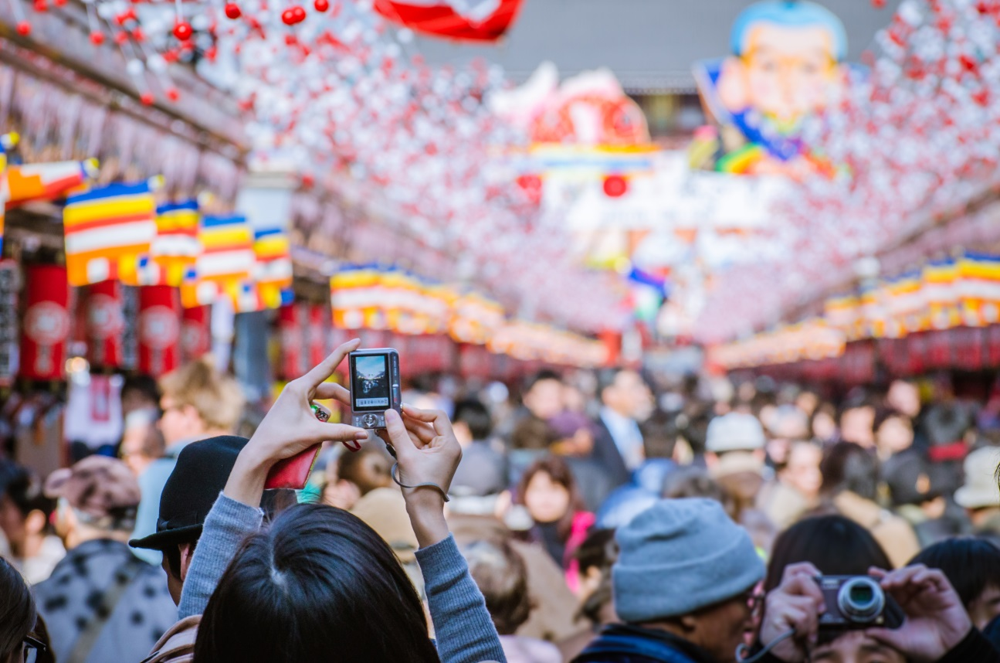
Keep People in the Picture

Slide 27
Best rationales to support conservation generally
are people-centric.
The best reason to conserve nature is to preserve the benefits people can derive from it ‐ for our economy, our health, and our enjoyment.
53%
The best reason to conserve nature is for its own sake ‐ to leave systems of plants and wildlife undisturbed to evolve, change and grow.
39%

Slide 28
And, the top rationale in support of funding wildlife conservation focuses on the health connection for people.
Clean air and clean water are essential to the survival of wildlife, but are important to our health and our quality of life as well. Protecting wildlife and the clean air and water they need will also benefit people.
72%
77%
All Voters
Advocates
Now, I am going to read you some statements some people have given as reasons to support increasing taxes
in order to implement your state's action plan to conserve wildlife. After I read each one, please tell me whether
you find this statement... very convincing, somewhat convincing, not too convincing, ...or...not convincing at all
as a reason to support increasing taxes in order to implement your state's action plan to conserve wildlife.

Slide 29
Future Generations

Slide 30
For example, a “future generations” message that connects voters to how saltwater fish and the ocean impact their lives resonated strongly as a reason for changing fisheries management policies.
From fishing, shrimping, crabbing or clamming, to enjoying seafood, having healthy populations of fish can enrich our lives. We owe it to our children and grandchildren to protect the health of not just a few fish species, but ensure the broader health of the oceans that sustain our coastal communities. We can do that better by taking a comprehensive fishery management approach to ensure fish populations rebound and stay healthy for the long term.
Very
Convincing
38%

Slide 31
Future generations was also a top message in support of wildlife action plans.
Ranked By % Very Convincing Among Voters
Clean air and clean water are essential to the survival
72%
of wildlife, but are important to our health and our
quality of life as well. Protecting wildlife and the clean
77%
air and water they need will also benefit people.
It is important to protect our wildlife for future
62%
generations, so that our children and grandchildren
can enjoy wildlife and nature.
55%
In this age of too much TV and video games, it is
54%
important for our children that we renew our shared,
outdoor pastimes and family traditions where wildlife
44%
is part of the enjoyment.
As growth and development continues in our state, we
50%
are taking up more and more of the space where
wildlife live and placing many birds and animals at risk.
65%
All Voters
Advocates
Now, I am going to read you some statements some people have given as reasons to support increasing taxes
in order to implement your state's action plan to conserve wildlife. After I read each one, please tell me whether
you find this statement... very convincing, somewhat convincing, not too convincing, ...or...not convincing at all
as a reason to support increasing taxes in order to implement your state's action plan to conserve wildlife.

Slide 32
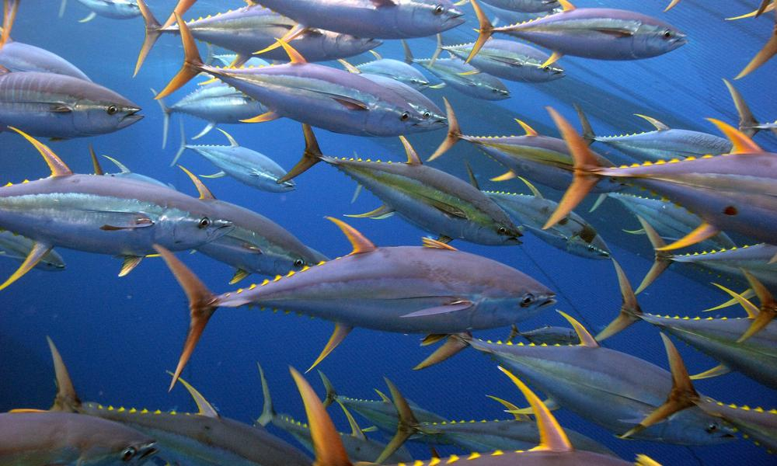
Scarcity is Scary

Slide 33
A majority believe most saltwater fish populations have declined.
Perceived Saltwater Fish Population Change Over The Last Five Years
Decreased
56%
Stayed about the same
35%
Increased
10%
In the last five years, would you say the populations of most saltwater fish in ocean waters off your state has –

Slide 34
Best rationales to support conservation generally
are people-centric.
We know we can have success in helping wildlife. In the past few decades, investments in protecting once-threatened animals – like the wild turkey, white-tailed deer, and numerous fish – have brought them back from the brink of extinction to having thriving, healthy populations. We can do the same for other animals if we just make the effort and investment now.
All Voters
47%
Advocates
56%
Now, I am going to read you some statements some people have given as reasons to support increasing taxes
in order to implement your state's action plan to conserve wildlife. After I read each one, please tell me whether
you find this statement... very convincing, somewhat convincing, not too convincing, ...or...not convincing at all
as a reason to support increasing taxes in order to implement your state's action plan to conserve wildlife.

Slide 35
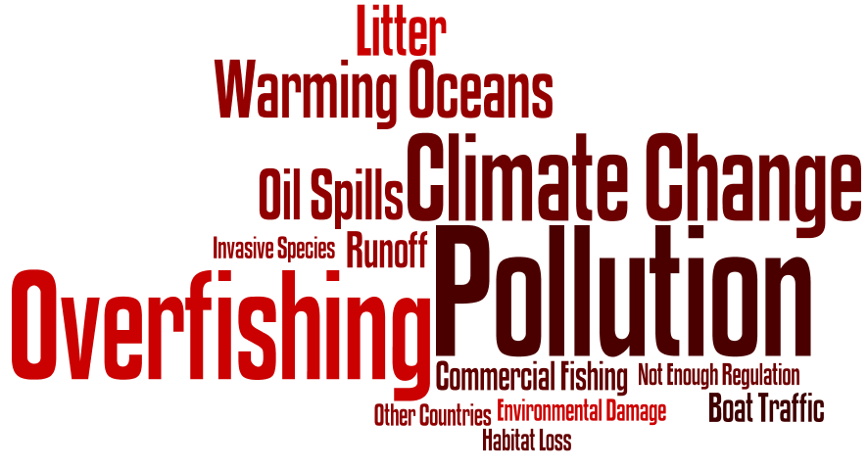
Many coastal Americans attribute fish decline to over-fishing, along with dirty and changing oceans.
To what do you attribute the (INCREASE/DECREASE) in most saltwater fish populations? In other words what do you think has (IMPROVED/GOTTEN WORSE) that has affected these fish?

Slide 36
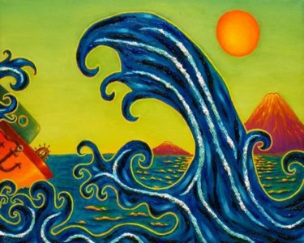
Know Climate Change is Challenging

Slide 37
Americans are divided on whether a scientific consensus on climate can be trusted.
I trust what scientists say when they warn about climate change.
48%
I think scientists manipulate their findings for political reasons.
43%
*Bloomberg Poll, June 2014

Slide 38
Many U.S. adults are hesitant in their views of climate science.
Climate scientists understand very well…
Whether climate change is occurring
The causes of climate change
The best ways to address it
Perception of scientific consensus
Almost all say climate change human-caused
Information on causes of climate change
Trust scientists a lot for full and accurate information
Research findings influenced by ____ most of the time
Best available evidence
Concern for public interest
Scientists’ desire to advance their careers
Scientists’ own political leanings
Researchers desire to help their industry
Pew Research Center, 2016

Slide 39
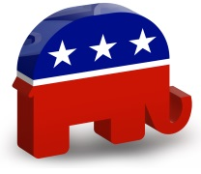
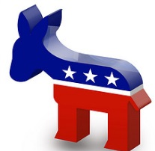
Climate Dynamics
Less Concerned
Seniors
White Men
More Concerned
Young Voters
Voters of Color
Republicans
Democrats

Slide 40
Views on global warming are most dramatically polarized by party.
Global Warming By Party and Party/Gender

Slide 41
That said, three-in-five hold the view that “the climate” in their state has changed recently.
Over the last few years, the climate in my state has been changing.

Slide 42
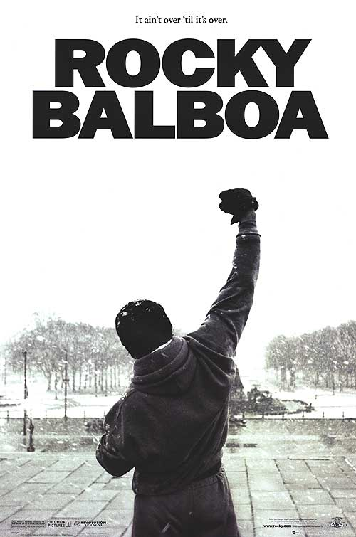
Dump “Resilience”
(and other confusing terms)

Slide 43
We have tested the concept of resilience in 20+ groups
and it evokes confusion or is counter-productive.
“Texans are tough…we come back.”
– Galveston Focus Group
“I think resilient is about, I think it is more about people, like we’re a resilient people because we can get through things, I mean they say that about New Englanders anyway, they can survive.”
- Boston area Focus group
“I don't think that many people would be able for fully discern what exactly resilient means. Those who have little education may not understand what exactly the reference is.”
- Opinion Elite, Female, Rating: 25, Str GOP
“Instead of being resilient it would be better if it didn't need to be resilient but instead made efforts at prevention of problems.”
– Independent woman in survey
“A city able to bounce back from problems, instead of being resilient it would be better if it didn't need to be resilient but instead made efforts at prevention of problems.”
– Voter, Female, Independent
“It is a bit confusing. Resilient to what?”
- Independent Woman in survey
“Is a bit confusing. Resilient to what?”
- Opinion Elite, Female, Rating: 20, IND
Only thought leaders saw “resilience” as positive, as it implied their community may have planned well.

Slide 44
“In your own words, what does the term ‘watershed’ mean to you?”
Don’t know: 47%
A geographic area through which water flows to a common destination: 27%
A building or shed used to store water: 26%
1999 survey of 850 Santa Clara County, CA residents

Slide 45
We can elicit very different concern levels about water quality just by describing pollution in non-technical language.
(Chesapeake Bay Watershed, 2004)

Slide 46
Words to Use and Avoid
Bad Words to Avoid | Good Words to Use
Environment | Land, air and water
Ecosystems | Natural areas
Biodiversity / endangered species | Fish and wildlife
Regulations | Safeguards/protections
Riparian | Land along lakes, rivers and streams
Aquifer | Groundwater
Watershed | Land around rivers, lakes and streams
Environmental groups | Conservation groups / organizations protecting land, air, and water
Agricultural land | Working farms and ranches
Urban sprawl | Poorly planned growth/ development
Green jobs | Clean energy jobs / jobs protecting water quality / etc.
Ecosystem services | Nature’s benefits
Green infrastructure | Nature-based solutions

Slide 47
Be Proactive and Prepared

Slide 48
Biggest plus of state wildlife action plans
was being pro-active.
Ranked By Much More Favorable
The main goal of this effort is to come up with a plan to help wildlife BEFORE an animal becomes so rare that it is expensive or impossible to save it.
In each state, scientists, sportsmen, farmers, and conservationists are all working together to develop a wildlife action plan for their state.
Each state is required to hold public meetings and ensure that its citizens have input on the development of the state's wildlife action plan.
Now, I am going to read you a list of statements regarding your state developing a wildlife action plan, and after I read each statement, please tell me whether it makes you feel – MORE FAVORABLE or LESS FAVORABLE – toward the state wildlife action plan or does it not make much difference in your opinion one way or the other?

Slide 49
Strong rationales in support of Nature-based Solutions.
Support Messages |  | Very Convincing
Voters | We spend billions every year to treat our drinking water. But it is more cost effective and simpler to prevent water pollution naturally – by protecting and restoring areas around sources of drinking water like wetlands ‐‐ than it is to treat water after it has been contaminated. | 40%
Opinion Elites | Smart investments made before a disaster strikes can help protect a community’s quality of life, save lives, and reduce the cost to taxpayers. Yet, the government makes it easier for communities to receive funding to rebuild after a disaster and provides few resources to reduce risks before a disaster strikes. We need a proactive, practical approach to help communities be prepared for disasters. | 48%
There are a number of reasons why some people say that communities should consider nature‐based solutions as part of their response to related problems. Please rate each of the following statements as to how convincing they are as a reason to ensure communities consider nature‐based solutions.

Slide 50
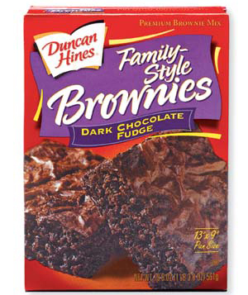
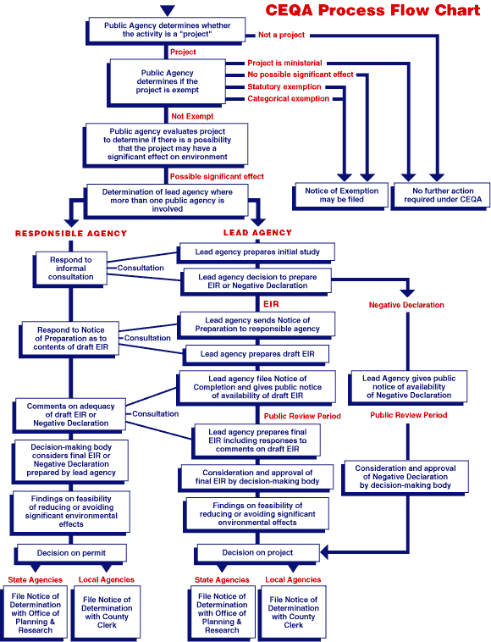
Talk Benefits, NOT Process.

Slide 51
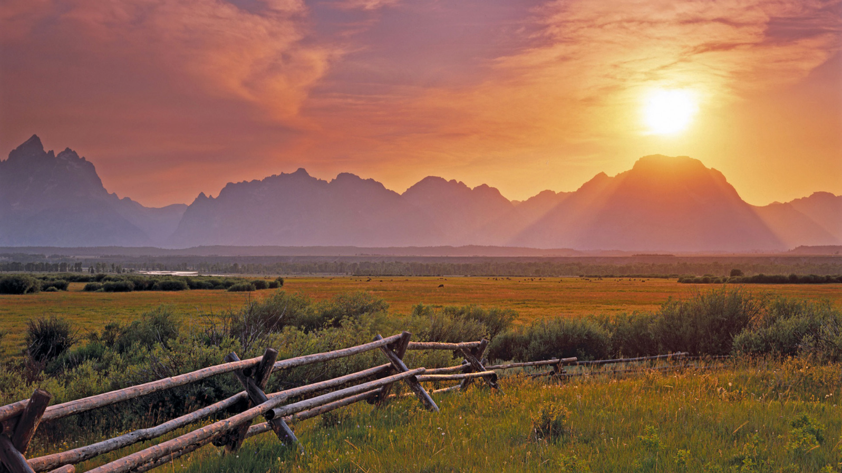
Least resonant message tested about wildlife action plans was process-oriented.
Much More Favorable
This kind of wildlife action plan has never been undertaken at this level before, so this is an historic opportunity.
32%

Slide 52
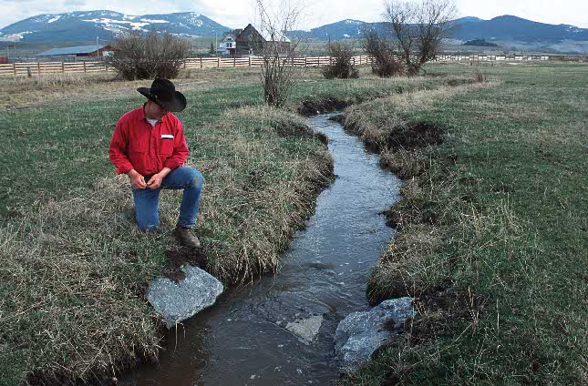
Except when conveying how you “work together” to solve problems.
Trout Unlimited Water Partners
Video: http://www.tu.org/node/358

Slide 53
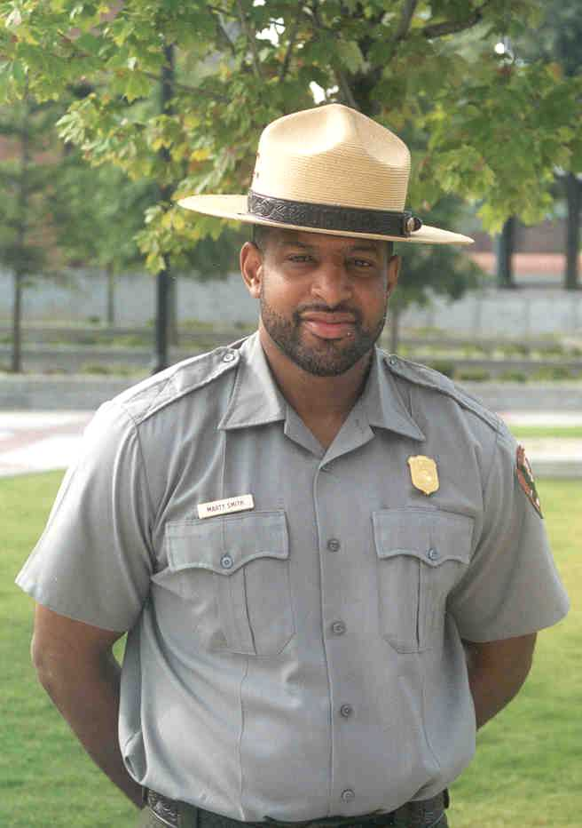
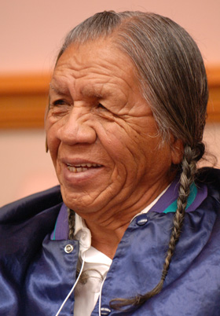
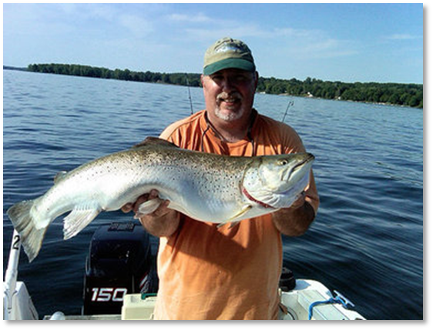
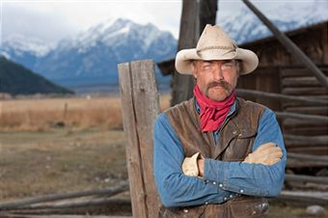
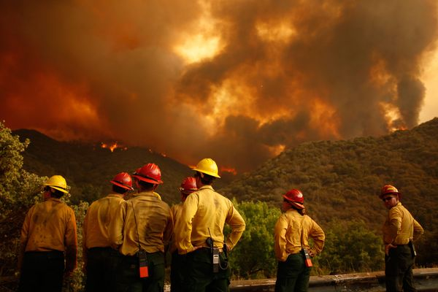
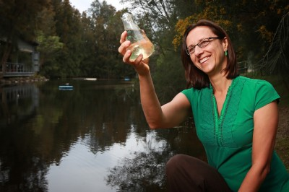
Find “Funny Hat” Messengers

Slide 54
When it comes to wildlife, voters place the most credibility
in those they perceive as not having a direct stake in wildlife.
Ranked By % Very Believable Among Voters
Park rangers
64%
44%
Biologists
54%
68%
State fish and wildlife agencies
53%
40%
Farmers and ranchers
36%
11%
Zoo officials
35%
21%
Conservation organizations
35%
63%
Fishermen and anglers*
29%
17%
Hunters
22%
16%
* Among advocates, asked as “Anglers”
All Voters
Advocates
Next, I'm going to read the names of some people and organizations that might speak out about
issues related to wildlife. After each one, please tell me whether or not you would consider those
people or that organization to be a believable source of information about wildlife. If you have
never heard of the people or organization, or have no opinion about them, please tell me that too.

Slide 55
Questions?

