Slide 1
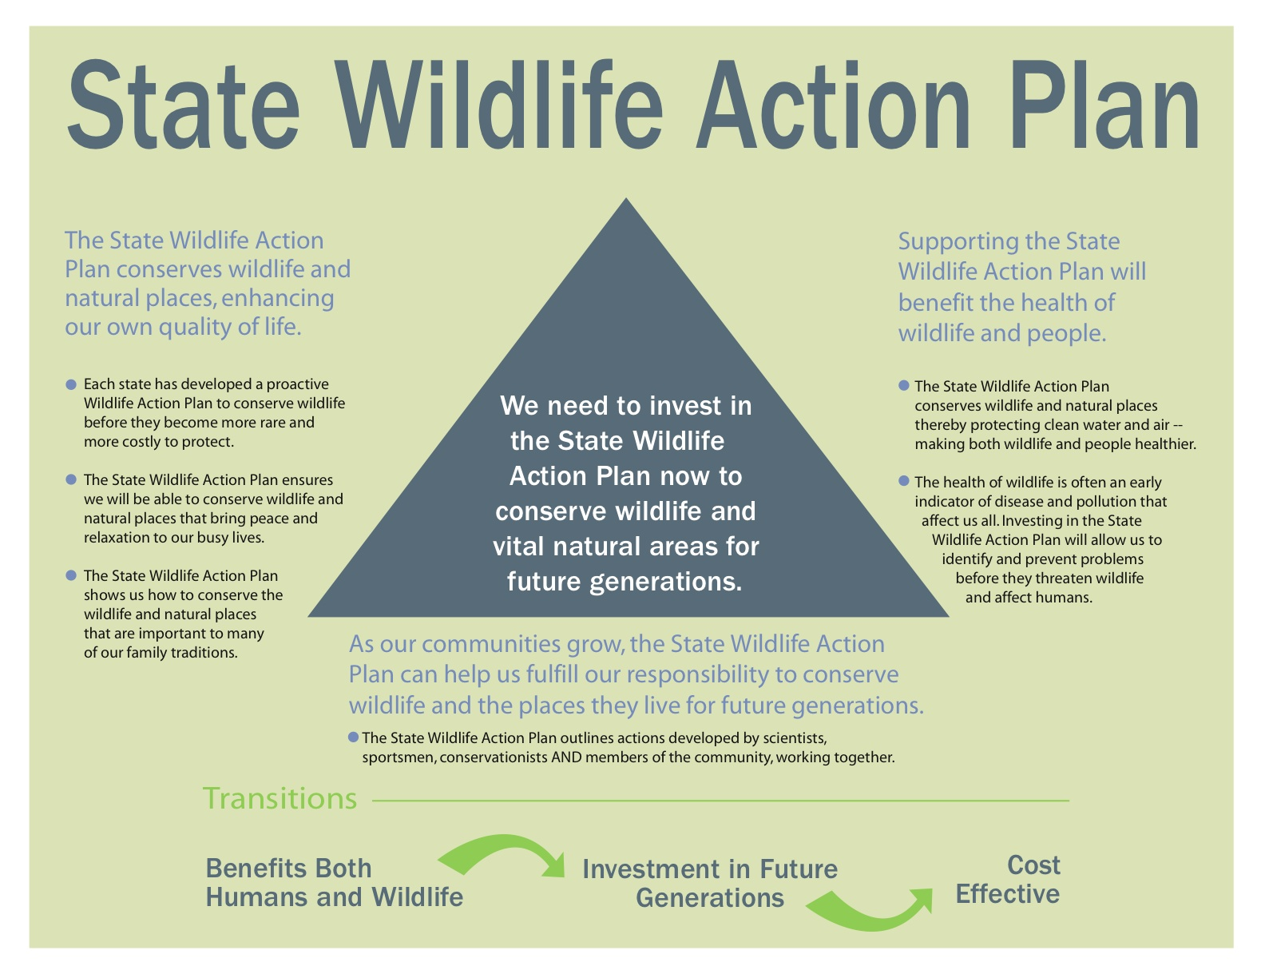

Slide 2
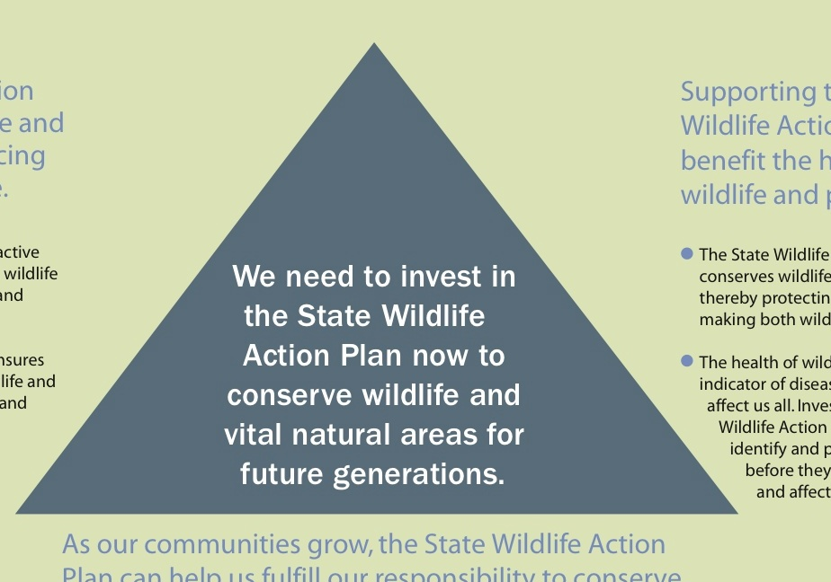
What we want

Slide 3
Where we meet public opinion

Slide 4
Getting back to our ground

